Slide 1
Grady Booch
Chief Scientist
Rational Software Corporation
The Future of Software
Notes:
1

Slide 2
The Present State of Software Engineering
The emerging confluence of social and technological trends
  The demand for access to and visualization of information
  The increasing availability and declining costs of distributed connectivity
The shift from atoms to bits
  Software as a strategic weapon
Fundamental constraints upon advancement
  The challenge over the next 20 years will not be speed or cost or performance; it will be a question of complexity. Bill Raduchel, Chief Strategy Officer, Sun (but now with AOL)

Slide 3







The Nature of Change
“It has been a long time in coming, but the industrial revolution of software is finally upon us.”
  Bill Gates
“Things have changed in the last twenty years.”
  - Bill Gates
“The times they are a changin’.”
  - Bob Dylan
“Toto, I don’t think we are in Kansas anymore.”
  - Dorothy
www.saic.com

Slide 4
Forces in Software
Functionality
Cost
Compatibility
Capacity
Fail safe
Availability
Fault tolerance
Performance
Throughput
Technology churn
Resilience

Slide 5
The Future of Software
Component based systems will dominate
More non-programmers will end up programming
Continuously evolving systems will become the norm for most organizations
Systems will become more distributed and more concurrent
There will continue to be technology churn
The “soft” practices of modeling, process, and architecture will gain greater acceptance

Slide 6
On The Horizon
In hardware
  Quantum computing
  Molecular computing
In software
  eXtreme programmin
  Aspect-oriented programming
  Intentional programming
  Executable architectures
Trends
- The drive to higher levels
of abstraction
- Team productivity versus
individual productivity

Slide 7
The Future of Software
The Future of Software
MIT Press
Component based systems will dominate
More non-programmers will end up programming
Continuously evolving systems will become the norm for most organizations
Systems will become more distributed and more concurrent
There will continue to be technology churn
The “soft practices of modeling, process, and architecture will gain greater acceptance

Slide 8
Component
A component is a physical and replaceable part of a system that conforms to and provides the realization of a set of interfaces.

Slide 9
Components
A component may be manifest as a
  CORBA object, COM/DCOM object, applet, serverlet, bean
A component is not a
  Class library, file
Creating a good component-based system requires a solid object-oriented foundation
Component-based systems are changing the way software is developed and deployed
  “We are seeing the merging of two great technologies: object-oriented programming and transaction processing monitors.” Roger Sessions
The wicked problems of software development will still remain
  Alternative object models are emerging

Slide 10
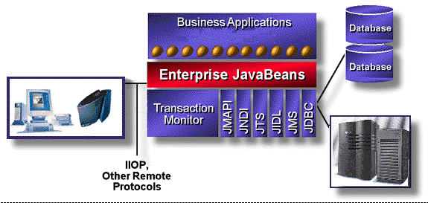
EJB architecture
Bill Roth, JavaSoft
©1998, Sun Microsystems, Inc.

Slide 11
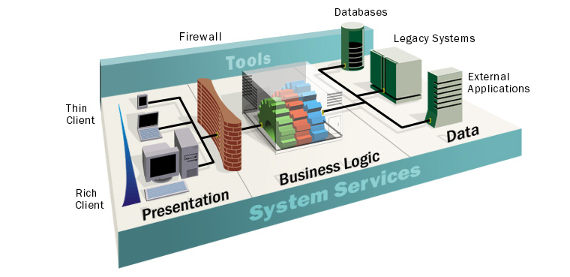
Microsoft DNA

Slide 12
The Future of Software
Component based systems will dominate
More non-programmers will end up programming
Continuously evolving systems will become the norm for most organizations
Systems will become more distributed and more concurrent
There will continue to be technology churn
The “soft practices of modeling, process, and architecture will gain greater acceptance

Slide 13
Programming without Programming
Visual programming
  Visual Age family (C++, Smalltalk, Java)
  Visual Studio (Visual Basic, C++, Java)
  4GL environments
  UML
There are pragmatic limits to the complexity of systems that can be built using these technologies
Visual programming does not eliminate the importance of architecture and process
  Human error amplified by technology

Slide 14
The Future of Software
Component based systems will dominate
More non-programmers will end up programming
Continuously evolving systems will become the norm for most organizations
Systems will become more distributed and more concurrent
There will continue to be technology churn
The “soft practices of modeling, process, and architecture will gain greater acceptance

Slide 15
Continuously Evolving Systems
The vocabulary of a domain changes slowly
The rules of that domain change rapidly
The pressure to develop on internet time

Slide 16
Shearing layers of change
How Buildings Learn
Stewart Brand,
Space plan
Services
Stuff
Structure
Skin
Site

Slide 17
The Future of Software
Component based systems will dominate
More non-programmers will end up programming
Continuously evolving systems will become the norm for most organizations
Systems will become more distributed and more concurrent
There will continue to be technology churn
The “soft practices of modeling, process, and architecture will gain greater acceptance

Slide 18
The Web Changes...
Everything...
  Every day it becomes more clear that the Net is taking its place alongside the other great transformational technologies that first challenged, and then fundamentally changed, the way things are done in the world. Lou Gerstner, IBM
Nothing…
  [The World Wide Web] combines the worst of TV with the worst of CB radio. Edward Tufte
Some things…
  It’s much like the old mainframe computing environment, where a Web browser is like a dumb terminal and the Web server is like the mainframe where all the processing’s done. Steve Jobs
  New patterns of visualization and access to information

Slide 19
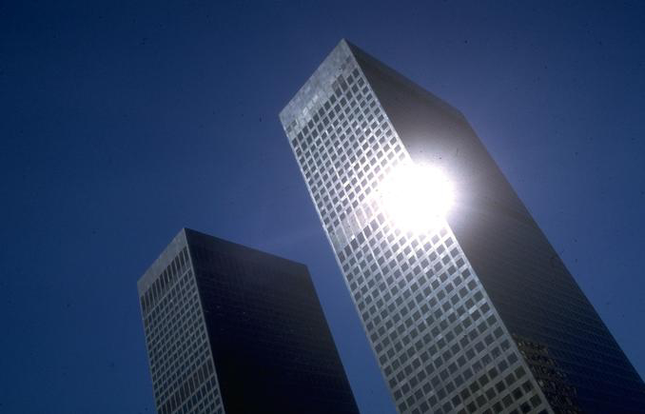

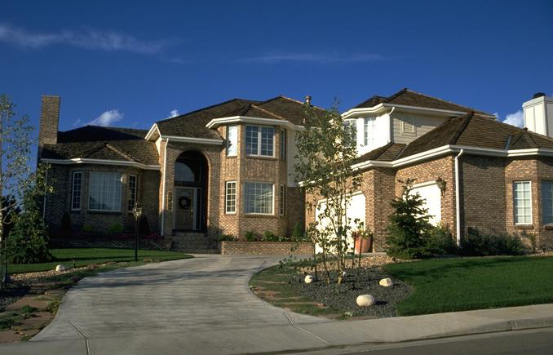
From Doghouses to High Rises
Most of us are running Web
sites and networks built of
straw or sticks
Scott Petersen, PC Week
Can be built by one person
Requires
Minimal modeling
Simple process
Simple tools
Built most efficiently and timely by a team
Requires
Modeling
Well-defined process
Power tools

Slide 20
Issues in Architecting Web-centric Systems
A web application is a web site where user input (navigation through the site and data entry) affects the state of the business. Jim Conallen, Rational
Stages in the evolution of web-centric systems
  Stage zero: document-centric
  Stage minus-one: eye candy
  Stage one: making the client and the server smarter
  Stage two: exchanging data and programs
  Stage three: pervasive, distributed computing
Issues
  Integration of legacy
  Continuous evolution
  Dealing with peak traffic

Slide 21
The Future of Software
Component based systems will dominate
More non-programmers will end up programming
Continuously evolving systems will become the norm for most organizations
Systems will become more distributed and more concurrent
There will continue to be technology churn
The “soft practices of modeling, process, and architecture will gain greater acceptance

Slide 22
Technology Churn
Languages
Operating systems
Browsers
Databases
Renaissance of embedded systems

Slide 23
The Future of Software
Component based systems will dominate
More non-programmers will end up programming
Continuously evolving systems will become the norm for most organizations
Systems will become more distributed and more concurrent
There will continue to be technology churn
The “soft practices of architecture, process, and modeling will gain greater acceptance

Slide 24
Software Best Practices
Develop Iteratively
Manage Requirements
Ensures users involved
as requirements evolve
Use Component Architectures
Validates architectural
decisions early on
Best
Practices
Model Visually (UML)
Addresses complexity of
design/implementation incrementally
Verify Quality
Measures quality early and often
Control Changes
Evolves baselines incrementally
www.spmn.com

Slide 25
Focus over time
Discovery
Invention
Focus

Slide 26
Unified Process
Phases
Process Workflows
Inception
Elaboration
Construction
Transition
Business Modeling
Requirements
Analysis & Design
Implementation
Test
Deployment
Supporting Workflows
Configuration Mgmt
Management
Environment
Preliminary
Iteration(s)
Iter.
#1
Iter.
#2
Iter.
#n
Iter.
#n+1
Iter.
#n+2
Iter.
#m
Iter.
#m+1
Iterations

Slide 27

The Evolution Of The UML
UML 1.3
OMG Acceptance, Nov 1997
Final submission to OMG, Sep ‘97
UML 1.1
public
feedback
First submission to OMG, Jan ´97
UML partners
UML 1.0
Web - June ´96
UML 0.9
OOPSLA ´95
Unified Method 0.8
Other methods
Booch method
OMT
OOSE

Slide 28
UML Partners
Rational Software Corporation
Hewlett-Packard
I-Logix
IBM
ICON Computing
Intellicorp
MCI Systemhouse
Microsoft
ObjecTime
Oracle
Platinum Technology
Taskon
Texas Instruments/Sterling Software
Unisys

Slide 29
Models and Views
A model is a complete
description of a system
from a particular
perspective
State
Diagrams
State
Diagrams
Class
Diagrams
Use Case
Diagrams
Use Case
Diagrams
State
Diagrams
Use Case
Diagrams
Use Case
Diagrams
State
Diagrams
Use Case
Diagrams
Object
Diagrams
Sequence
Diagrams
Scenario
Diagrams
State
Diagrams
Scenario
Diagrams
State
Diagrams
Collaboration
Diagrams
Component
Diagrams
Models
Scenario
Diagrams
Component
Diagrams
Scenario
Diagrams
Component
Diagrams
Statechart
Diagrams
Deployment
Diagrams
Activity
Diagrams

Slide 30
Representing System Architecture
Logical View
Implementation View
End-user
Programmers
Software management
Functionality
Use Case View
Process View
Deployment View
System integrators
System engineering
Performance
Scalability
Throughput
System topology
Delivery, installation
Communication
Conceptual
Physical

Slide 31
Patterns
Design Patterns
Gamma et al
A pattern is a solution to a problem in a context
  A pattern also expresses its author’s intent
A pattern codifies specific knowledge collected from experience in a domain
  Patterns capture common analysis and design solutions
All well-structured systems are full of patterns
  Idioms
  Mechanisms
  Frameworks
Vertical domain frameworks are emerging
  San Francisco, Insurance Application Architecture
Horizontal domain frameworks are the low hanging fruit
  Publish only, publish with order … Amazon-in-a-box

Slide 32
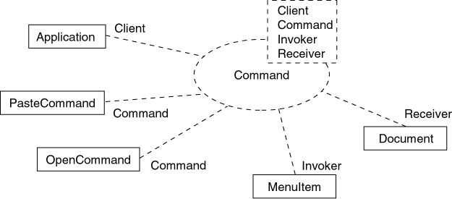
Modeling a design pattern

Slide 33
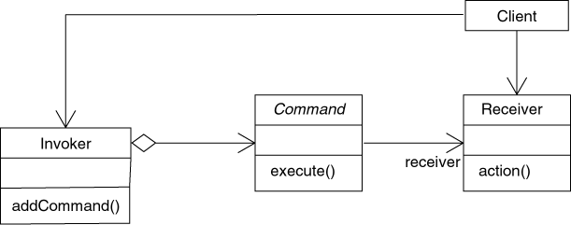
Modeling a design pattern (cont.)

Slide 34
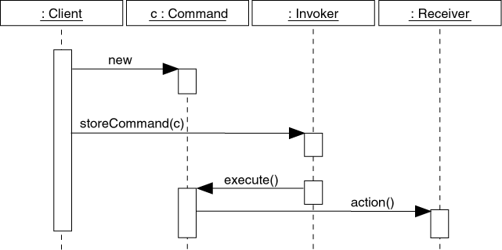
Modeling a design pattern (cont.)

Slide 35
General Observations
Codification of web-centric patterns
Ubiquitous distributed devices
Development as a team sport
Management of complexity
-- Moving from doghouses
to high rises

Slide 36
Points of Contact
Email: egb@rational.com
Web: http://www.rational.com

